Slide 1
Software Engineering
Lecture-9

Slide 2
Object behaviour modelling
A behavioural model shows the interactions between objects to produce some particular system behaviour that is specified as a use-case.
Sequence diagrams (or communication diagrams) in the UML are used to model interaction between objects.

Slide 3
Sequence models
Sequence models show the sequence of object interactions that take place
  Objects are arranged horizontally across the top
  Time is represented vertically so models are read top to bottom
  Interactions are represented by labelled arrows, Different styles of arrow represent different types of interaction
  A thin rectangle in an object lifeline represents the time when the object is the controlling object in the system

Slide 4
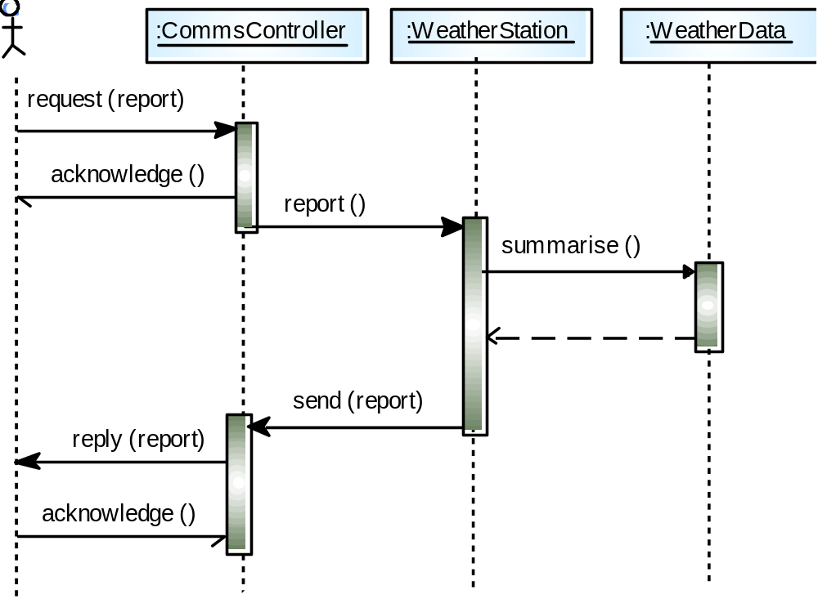
Data collection sequence

Slide 5
Statecharts
Show how objects respond to different service requests and the state transitions triggered by these requests
  If object state is Shutdown then it responds to a Startup() message
  In the waiting state the object is waiting for further messages
  If reportWeather () then system moves to summarising state
  If calibrate () the system moves to a calibrating state
  A collecting state is entered when a clock signal is received

Slide 6
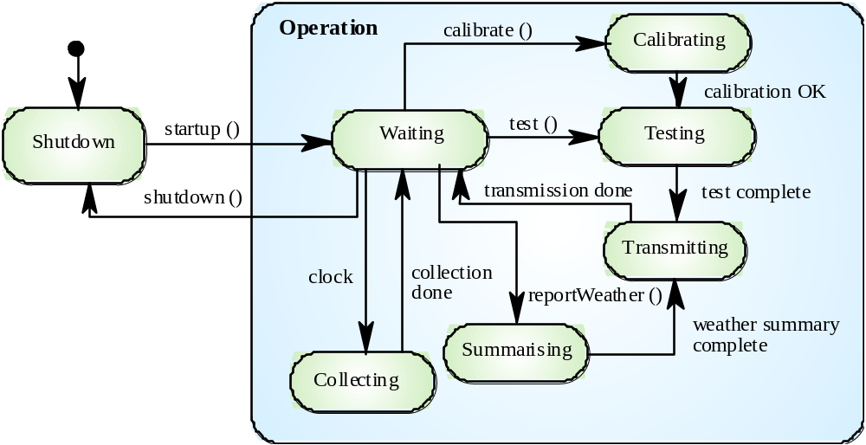
Weather station state diagram

Slide 7
Design evolution
Hiding information inside objects means that
changes made to an object do not affect other
objects in an unpredictable way.
Assume pollution monitoring facilities are to be
added to weather stations. These sample the
air and compute the amount of different
pollutants in the atmosphere
Pollution readings are transmitted with weather
data

Slide 8
Changes required
Add an object class called ‘Air quality’ as part of WeatherStation
Add an operation reportAirQuality to WeatherStation.
Modify the control software to collect pollution readings
Add objects representing pollution monitoring instruments

Slide 9
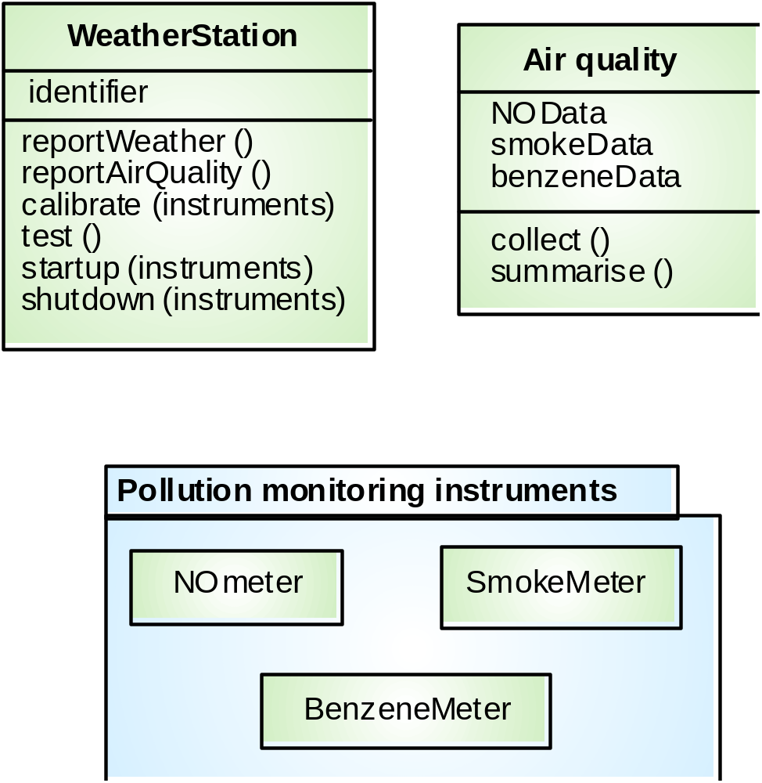
Pollution monitoring

Slide 10
Key points
OOD is an approach to design so that design components have their own private state and operations
Objects should have constructor and inspection operations. They provide services to other objects
Objects may be implemented sequentially or concurrently
The Unified Modeling Language provides different notations for defining different object models

Slide 11
User interface design

Slide 12
The user interface
User interfaces should be designed to match the skills, experience and expectations of its anticipated users.
System users often judge a system by its
interface rather than its functionality.
A poorly designed interface can cause a user to make catastrophic errors.
Poor user interface design is the reason why so many software systems are never used.

Slide 13
Human factors in Interface Design
Limited short-term memory
  People can instantaneously remember about 7 items of information. If you present more than this, they are more liable to make mistakes.
People make mistakes
  When people make mistakes and systems go wrong, inappropriate alarms and messages can increase stress and hence the likelihood of more mistakes.
People are different
  People have a wide range of physical capabilities. Designers should not just design for their own capabilities.
People have different interaction preferences
  Some like pictures, some like text.

Slide 14
UI design principles
UI design must take account of the needs, experience and capabilities of the system users.
Designers should be aware of people’s physical and mental limitations (e.g. limited short-term memory) and should recognise that people make mistakes.
UI design principles underlie interface designs although not all principles are applicable to all designs.

Slide 15
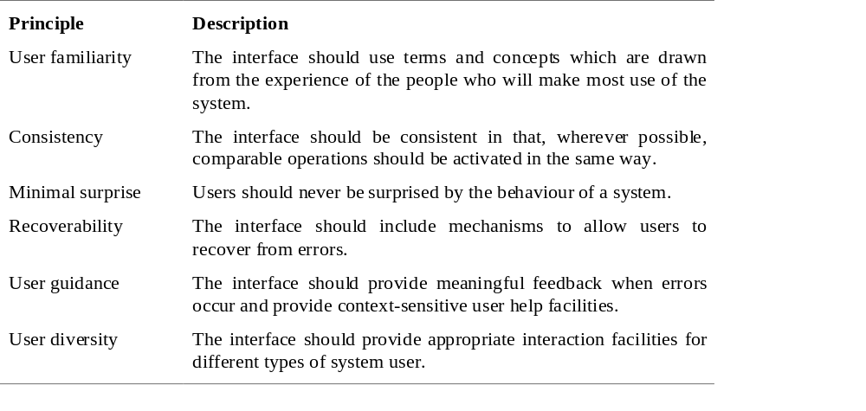
User interface design principles

Slide 16
Design principles
User familiarity
  The interface should be based on user-oriented
  terms and concepts rather than computer concepts. For example, an office system should use concepts such as letters, documents, folders etc. rather than directories, file identifiers, etc.
Consistency
  The system should display an appropriate level
  of consistency. Commands and menus should have the same format, command punctuation should be similar, etc.
Minimal surprise
  If a command operates in a known way, the user should be
  able to predict the operation of comparable commands

Slide 17
Design principles
Recoverability
  The system should provide some resilience to
  user errors and allow the user to recover from errors. This might include an undo facility, confirmation of destructive actions, 'soft' deletes, etc.
User guidance
  Some user guidance such as help systems, on-line manuals, etc. should be supplied
User diversity
  Interaction facilities for different types of user should be supported. For example, some users have seeing difficulties and so larger text should be available

Slide 18
Design issues in UIs
Two problems must be addressed in interactive systems design
  How should information from the user be provided to the computer system?
  How should information from the computer system be presented to the user?
User interaction and information presentation may be integrated through a coherent framework such as a user interface metaphor.

Slide 19
Interaction styles
Direct manipulation
Menu selection
Form fill-in
Command language
Natural language

Slide 20
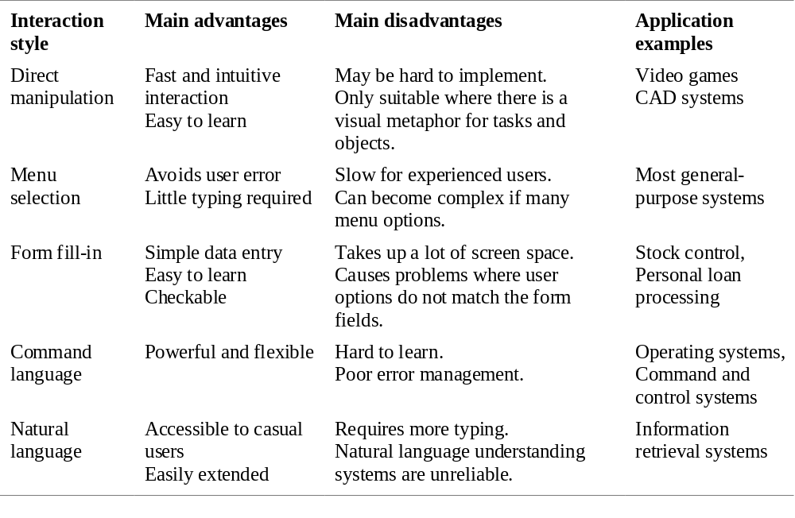
Interaction styles

Slide 21
Web-based interfaces
Many web-based systems have interfaces based on web forms.
Form field can be menus, free text input, radio buttons, etc.
In the LIBSYS example, users make a choice of where to search from a menu and type the search phrase into a free text field.

Slide 22
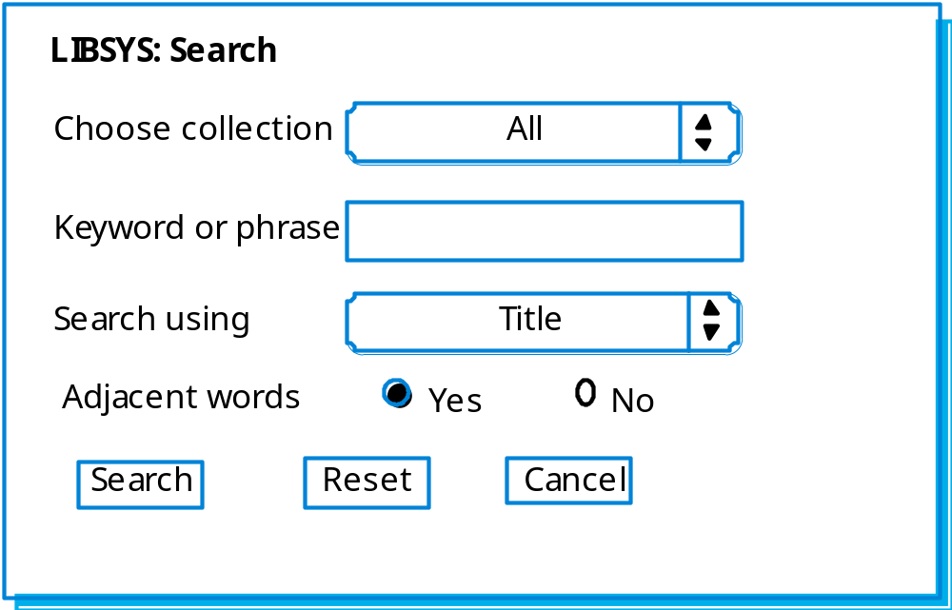
Example

Slide 23
Information presentation
Information presentation is concerned with presenting system information to system users.
The information may be presented directly (e.g. text in a word processor) or may be transformed in some way for presentation (e.g. in some graphical form).

Slide 24
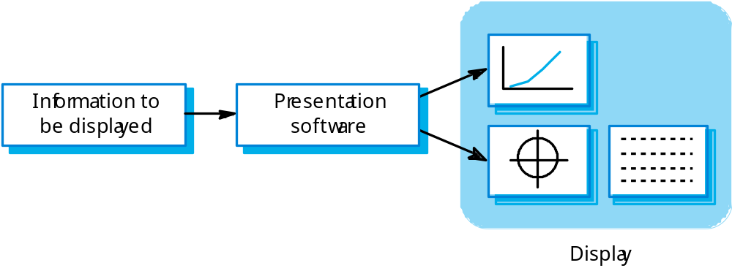
Information presentation

Slide 25
Information presentation
Static information
  Initialised at the beginning of a session. It does not change during the session.
  May be either numeric or textual.
Dynamic information
  Changes during a session and the changes must be communicated to the system user.
  May be either numeric or textual.

Slide 26
The UI design process
UI design is an iterative process involving close liaisons between users and designers.
The 3 core activities in this process are:
  User analysis. Understand what the users will do with the system;
  System prototyping. Develop a series of prototypes for experiment;
  Interface evaluation. Experiment with these prototypes with users.

